Slide 1


JOB RECOMMENDER
SMART-O-THON

Slide 2
ABOUT THIS PROJECT
Collect and analyze job seeker data: The first step is to gather information about job seekers which includes skills. This data can be collected through online applications, resumes, and other sources. AI algorithms can then analyze this data to identify patterns and preferences.
Gather and analyze job data: The next step is to collect and analyze job data, including job descriptions, required qualifications, and company culture. This information can be obtained from job postings, company websites, and other sources. AI algorithms can then analyze this data to identify the key requirements and characteristics of each job.
Match job seekers with suitable jobs: Once the job seeker and job data have been analyzed, the AI system can begin to match job seekers with suitable job opportunities. The system can use machine learning algorithms to identify the best matches based on factors such as job requirements, job seeker skills, education, and work experience.
Flexibility: This ML model also provides the job seeker with the role in the company and also shows the location of where that particular job is available.

Slide 3
PROBLEM
The traditional job search process can be time-consuming and frustrating for both job seekers and employers. Job seekers often have to sift through numerous job postings that may not match their skills, experience, or preferences. Employers, on the other hand, may receive a large number of applications from unqualified candidates, making it difficult to identify the best candidates for the job.
AIM
An AI-based solution for job matching aims to streamline the job search process by using machine learning algorithms to match job seekers with suitable job opportunities. By analyzing job seeker and job data, the system can identify the best matches based on factor job seeker skills.
WHY PEOPLE SHOULD USE IT
People should use an AI-based solution for job matching because it can significantly increase the efficiency and effectiveness of the job search process. Job seekers can save time and effort by receiving personalized job recommendations based on their qualifications and preferences, while employers can save time and resources by receiving applications from the most qualified candidates. Overall, an AI-based job matching system can help both job seekers and employers find the best possible job matches, leading to more successful and satisfying employment outcomes.

Slide 4
CHALLENGES FACED
DATA QUALITY
The success of an AI-based job matching system is heavily dependent on the quality and quantity of the data used to train the machine learning algorithms. Ensuring that the data is accurate, relevant, and up-to-date can be a significant challenge.
SCALABILITY
As the number of users and job postings increases, the system needs to be able to handle the increased load without compromising performance.
DEPLOYMENT
http://datageekstechnoverse.pythonanywhere.com/
Issue with the module installations, will be resolved shortly.

Slide 5






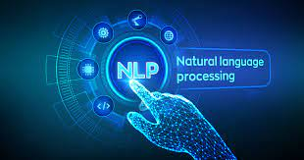
PROGRAMMING LANGUAGES USED
HTML
GOOLE COLAB
FLASK
CSS
SCIKIT LEARN
PYTHON
NLP

Slide 6


LINKS
HR_1 & HR_2
https://github.com/shrishail356/Data_Geeks_Smart_O_Thon
https://drive.google.com/file/d/1F_VPOnBnA9mVEihxhXPMetBTELGyG60R/view?usp=sharing
DATASET

Slide 7
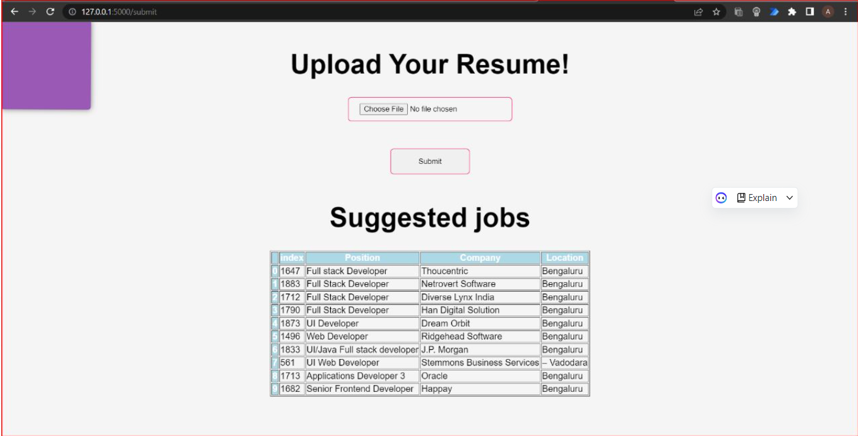
PICTURES

Slide 8
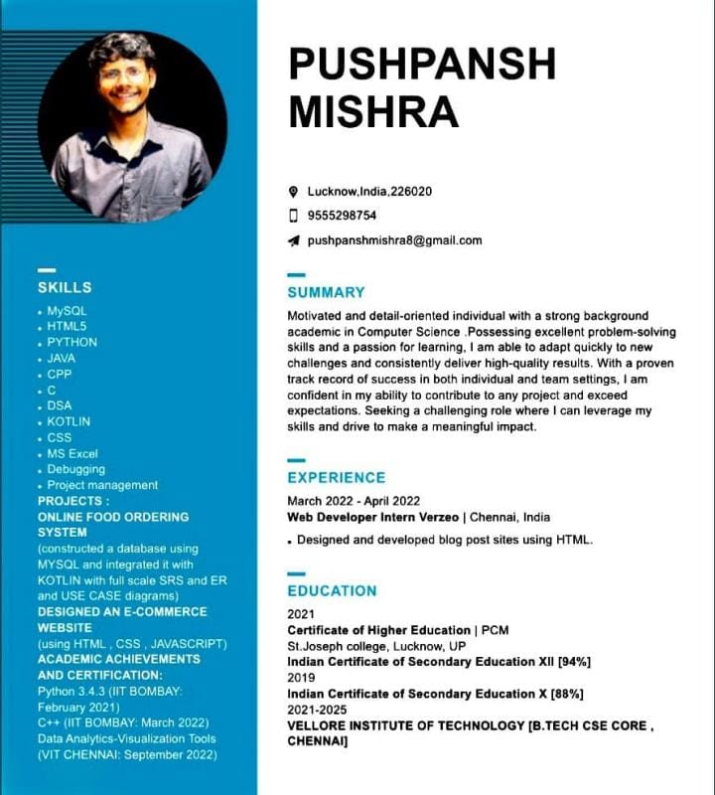
RESUME FOR THE ABOVE OUTPUT

Slide 9
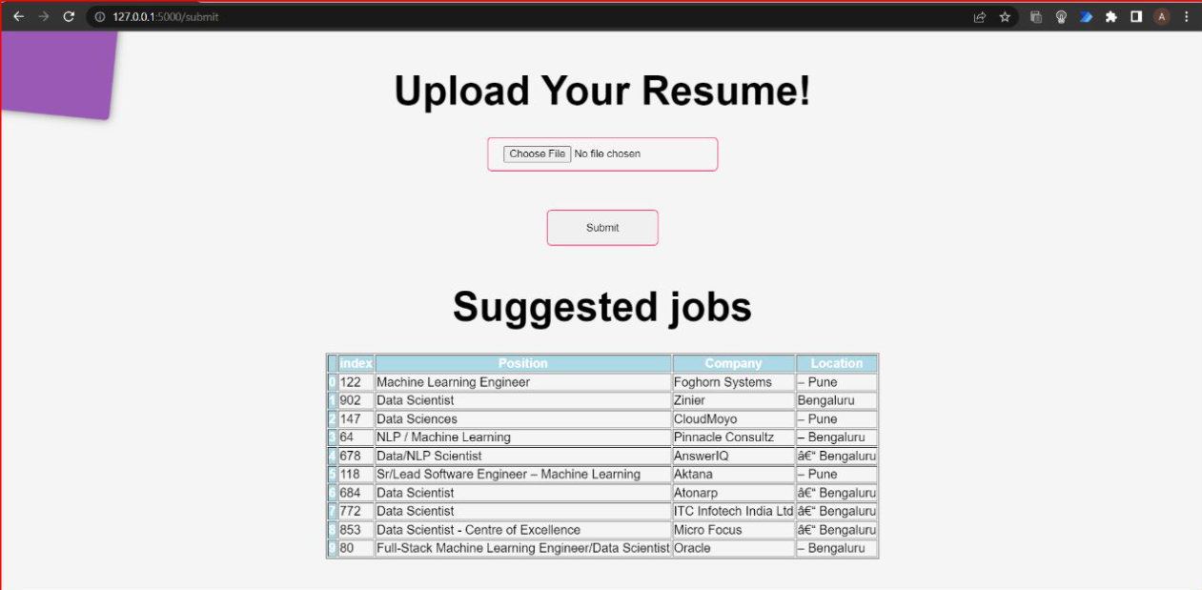

Slide 10
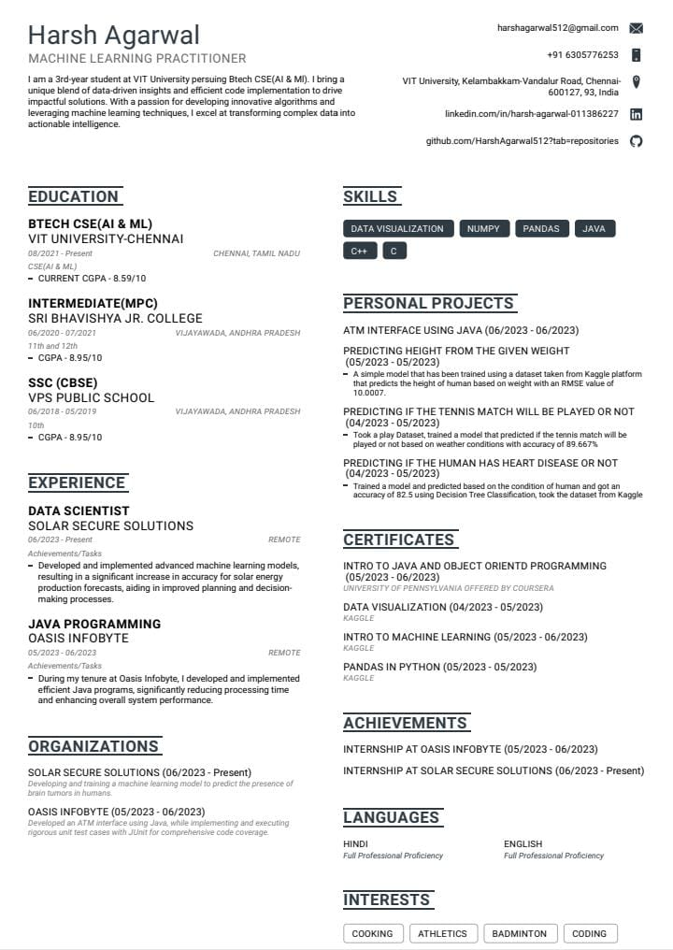
RESUME FOR THE ABOVE OUTPUT

Slide 11
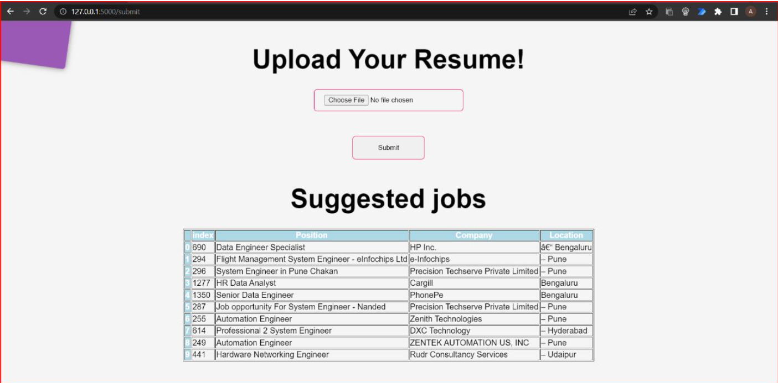

Slide 12
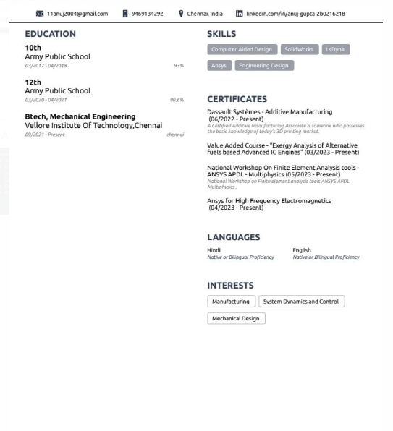
RESUME FOR THE ABOVE OUTPUT

Slide 13
TEAM MATES:
ADITYA CHOUDHARY
SHRISHAIL M PATIL
HARSH AGARWAL

